Slide 1

DEPARTMENT OF COMPUTER SCIENCE AND ENGINEERING
TRAFFIC MANAGEMENT
TEAM NAME: TEAM MEMBERS:
Proj_224783_Team_6 MANCHU PALLAVI(113321104055)
MANNEM HEMA SRI(113321104056)
MEESALA PRAVALLIKA(113321104057)
MEGHAA V(113321104058)

Slide 2
PROJECT
An Internet of Things (IoT)-enabled intelligent traffic management system can solve pertinent issues by leveraging technologies like wireless connectivity & intelligent sensors. Considered a cornerstone of a smart city, they help improve the comfort and safety of drivers, passengers & pedestrians.
A Traffic Management System (TMS) with Internet of Things (IoT) integration leverages IoT devices and sensors to collect, process, and manage traffic data in a more efficient and data-driven manner. IoT-enabled TMS offers real-time monitoring, analysis, and control of traffic flow, resulting in improved safety, reduced congestion, and enhanced overall traffic management. Here's an overview of a Traffic Management System project with IoT integration

Slide 3
PLATFORM REQUIRED
Hardware Selection: Choose IoT devices and sensors suitable for your TMS, including cameras, radar, vehicle detection sensors, environmental sensors, and IoT-connected traffic lights. Ensure that these devices are capable of collecting relevant data.
Communication Infrastructure: Set up a robust communication network to connect IoT devices to the central control system. This may involve using technologies like 5G, LPWAN, or a dedicated IoT network
Data Collection: Deploy IoT sensors at key locations to collect real-time data on traffic conditions, vehicle speeds, environmental factors, and incidents. Ensure data accuracy and reliability.
Data Processing and Analytics: Implement a cloud-based platform for data storage, management, and analytics. This platform should be capable of processing and analyzing the data generated by IoT devices
Control Center: Establish a centralized control center where traffic data is monitored, analyzed, and decisions are made to optimize traffic flow. This center should be staffed with trained personnel.

Slide 4
WEB DEVELOPMENT TECHNOLOGIES:
Web-Based IoT Dashboards: Web technology allows users to access and control IoT devices through web-based dashboards. Users can monitor and manage IoT devices remotely using a web browser, making it convenient and accessible from various devices
Data Visualization: Web technologies enable the creation of interactive data visualization interfaces. IoT data can be presented in a user-friendly and visually informative way through web applications, making it easier for users to interpret data and make decisions
Real-Time Monitoring: IoT data can be streamed in real-time to web applications, allowing users to monitor the status of devices, sensors, and systems as events occur. This real-time monitoring is invaluable for applications like home automation, industrial control, and environmental monitoring.
Cloud Services for IoT: Many IoT platforms and services are hosted on the cloud. Users can access these platforms through web browsers, enabling the management of large-scale IoT deployments and data analysis in the cloud.

Slide 5
Web APIs and Standards: Web technologies facilitate the creation of standard APIs (Application Programming Interfaces) for IoT devices and platforms. This allows developers to build applications that can communicate with various IoT devices using web standards like HTTP and WebSocket.
Interoperability: Web technology provides a standardized way for different IoT devices and systems to interact and share data, promoting interoperability and reducing vendor lock-in. Standards like RESTful APIs, MQTT, and CoAP are commonly used for this purpose.
Mobile Integration: IoT devices can be controlled and monitored through mobile web apps, extending the reach of IoT solutions to smartphones and tablets. This mobile integration is essential for user convenience and flexibility.
Security: Web security mechanisms, such as HTTPS and OAuth, can be applied to IoT communication to ensure the confidentiality and integrity of data. Security protocols are crucial in IoT, and web technology can provide a framework for securing IoT communication.

Slide 6
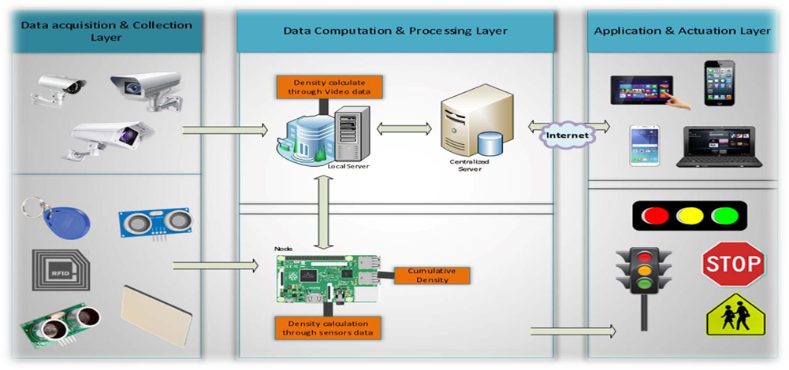
IOT SENSOR SETUP

Slide 7
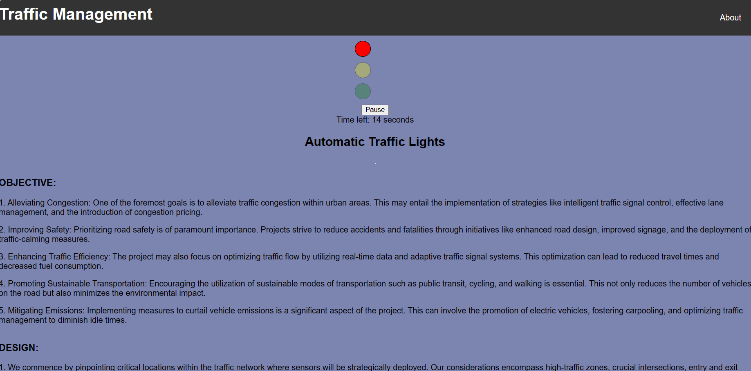
REAL-TIME WEBSITE
Click here to check my website

Slide 8
CONCLUSION
In conclusion, a well-designed traffic management system plays a crucial role in enhancing road safety, reducing congestion, and improving overall transportation efficiency. By utilizing technologies like traffic lights synchronization, real-time traffic monitoring, and data analytics, cities can make significant strides in managing traffic effectively. Additionally, promoting sustainable transportation options and public awareness can further contribute to a smoother and more sustainable urban mobility landscape. Overall, the implementation of a comprehensive traffic management system is essential for modern cities to address the challenges of urbanization and create a more livable and efficient environment for their residents.

Slide 9
THANK YOU

